Slide 1


CARING FOR THOSE YOU LEAD
Mental Health, Trauma, and the Church

Slide 2


VC
Notes:
Today we are going to ask you to take a journey to consider what life might be like for people who may or may not share some of the same experiences. Their journey in life may look different or similar to your own journey.

Slide 3

WHAT IS MENTAL HEALTH?
Mental health includes our emotional, psychological, and social well-being (and spiritual). It affects how we think, feel, and act and helps determine how we handle stress, relate to others, and make choices
(Substance Abuse and Mental Health Services Administration)
Mental health involves effective functioning in daily activities resulting in productive activities (work, school, caregiving), fulfilling relationships, and the ability to adapt to change and cope with adversity.
VC
Notes:
https://www.samhsa.gov/mental-health
https://www.ncbi.nlm.nih.gov/books/NBK44246/

Slide 4
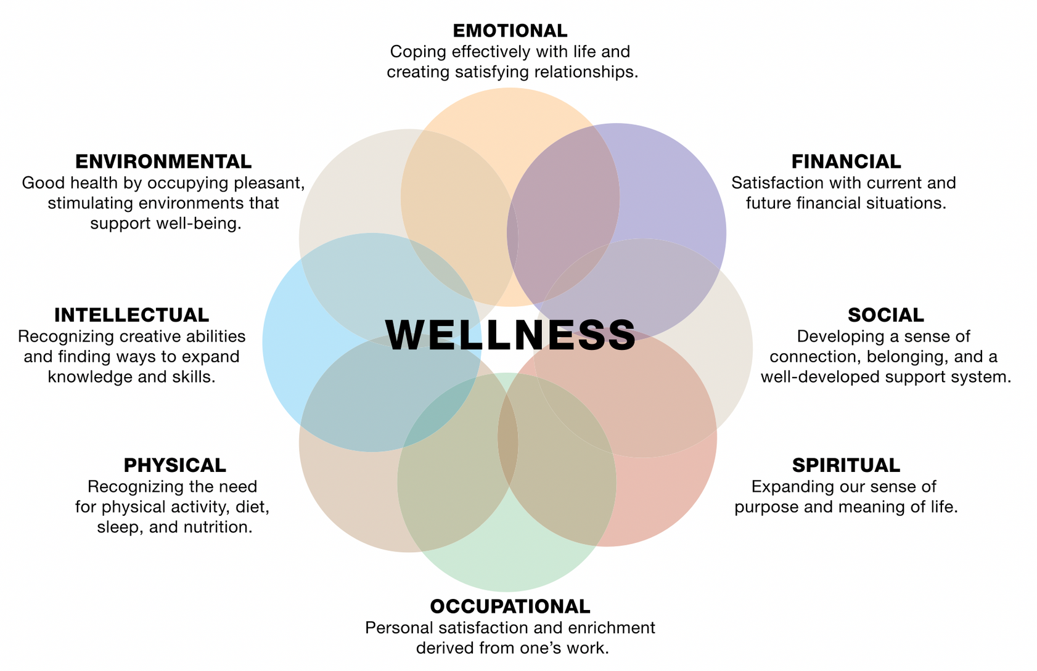
RECOVERY, WELLNESS, BUILDING RESILIENCE
CB
Notes:
Holistic Wellness
https://store.samhsa.gov/sites/default/files/sma16-4957.pdf

Slide 5

MENTAL HEALTH BY THE NUMBERS
22.8% OF U.S. ADULTS EXPERIENCED MENTAL ILLNESS IN 2021 (57.8 MILLION PEOPLE).
16.5% OF U.S.YOUTH AGED 6-17 EXPERIENCED A MENTAL HEALTH DISORDER IN 2016 (7.7 MILLION PEOPLE)
33.5% OF U.S. ADULTS WITH MENTAL ILLNESS ALSO EXPERIENCED A SUBSTANCE USE DISORDER IN 2021 (19.4 MILLION PEOPLE)
SUICIDE IS ONE LEADING CAUSE OF DEATH IN THE U.S.
CB
Notes:
https://www.nami.org/about-mental-illness/mental-health-by-the-numbers/#:~:text=22.8%25%20of%20U.S.%20adults%20experienced,represents%201%20in%2020%20adults.
Any of these surprise you?

Slide 6
MENTAL HEALTH IN THE CHURCH
23% OF PASTORS ACKNOWLEDGE THEY HAVE PERSONALLY STRUGGLED WITH A MENTAL ILLNESS.
49% OF PASTORS SAY THEY RARELY OR NEVER SPEAK TO THEIR CONGREGATION ABOUT MENTAL ILLNESS.
65% OF CHURCH GOING FAMILY MEMBERS OF THOSE WITH MENTAL ILLNESS WANT THEIR CHURCH TO OPENLY TALK ABOUT MENTAL ILLNESS.
Notes:
https://www.christianitytoday.com/news/2014/september/1-in-4-pastors-have-mental-illness-lifeway-focus-on-family.html

Slide 7
MENTAL HEALTH IN THE CHURCH
32% OF CHURCH GOERS SAY A CLOSE ACQUAINTANCE OR FAMILY MEMBER HAS DIED BY SUICIDE.
4% OF CHURCH GOERS WHO LOST A LOVED ONE TO SUICIDE SAY CHURCH LEADERS WERE AWARE OF THEIR LOVED ONE’S STRUGGLES.
68% OF AMERICANS FEEL THEY WOULD BE WELCOME IN CHURCH IF THEY WERE MENTALLY ILL.
70-90% OF AMERICANS HAVE EXPERIENCED TRAUMA.
CB
Notes:
https://place.asburyseminary.edu/cgi/viewcontent.cgi?article=2508&context=ecommonsatsdissertations
https://research.lifeway.com/2020/12/11/mental-health-declines-among-americans-except-weekly-churchgoers/

Slide 8




THE RIPPLE EFFECT
Having a mental illness can make it challenging to live an everyday life and maintain recovery. Beyond the individual, these challenges ripple out through our families, our communities, and our world.
PERSON
FAMILY
COMMUNITY
WORLD
VC
Notes:
This is also how the church wants to minister.
-Layered parts of ministry from the church's lens.
BREAKDOWN IN THE SYSTEM
-no way to escape the brokenness,
--where the breakdowns are occurring.
PERSON:
Individuals diagnosed with mental illnesses are at increased risk for certain physical ailments. For example, the risk of cardiovascular and metabolic disease is doubled in adults with serious mental illness.
People with depression have a 40% higher risk of developing cardiovascular and metabolic diseases.
https://www.nami.org/about-mental-illness/mental-health-by-the-numbers/#:~:text=People%20with%20depression%20have%20a,likely%20to%20develop%20these%20conditions.&text=Students%20aged%206%2D17%20with,likely%20to%20repeat%20a%20grade.
People with chronic mental illness are also at risk of developing a substance abuse disorder and are at greater risk for diabetes, hypertension, and stroke.
Conversely, those dealing with chronic physical illness are more likely to experience mental illnesses such as anxiety and depression.
Unemployment is higher among US adults who have mental illness compared to those who do not.
FAMILY:
At least 8.4 million people in the US provide care to an adult with a mental or emotional health issue.
A study published in the Journal of the American Medical Association for (JAMA) Pediatrics found that parents caring for a child with mental health concerns are more likely to experience their own mental health issues, including anxiety and depression.
Parents caring for a child with mental health concerns often have less time for other children in the family. This may lead to feelings of jealousy and resentment from the other children, who can display attention seeking behaviors. Additionally, parents may have less time for their own relationships or social activities.
COMMUNITY:
People living with mental illnesses often experience higher rates of homelessness, incarceration, or marginalization by their communities.
Additionally, around 80% of people receiving public mental health services are unemployed, even though many of them want to work.
21% of people experiencing homelessness in the US have a serious mental health condition.
Among people in the US under age 18, depressive disorders are the most common cause of hospitalization.
WORLD:
Depression is the leading cause of disability worldwide.
https://www.ncbi.nlm.nih.gov/pmc/articles/PMC3137804/#:~:text=Depression%2C%20the%20common%20psychological%20disorder,the%20global%20burden%20of%20disease.
Depression and anxiety disorders cost the global economy $1 trillion in lost productivity each year
https://www.ncbi.nlm.nih.gov/pmc/articles/PMC9925363/#:~:text=Lost%20productivity%20alone%20for%20depression,trillion%20by%202030%20%5B2%5D.

Slide 9


BREAK THE SILENCE
Children don’t experience
mental health issues.
People can “snap out of it”
if they wanted to.
People with mental health
conditions are violent
or chaotic.
There is no hope for people who
experience mental health issues.
They will never recover.
Mental health issues are a
result of personality
weakness or character
flaws.
VC
Notes:
Far too often, individuals battling mental illness are met with judgment, shame and isolation instead of understanding and empathy they desperately need.
Mental health is not a sign of weakness or lack of faith. It it a complex interplay of biological, psychological, and social factors that can affect anyone, regardless of religious beliefs.
Depression, anxiety, bipolar disorder, ADHD, and other mental health conditions can impact members of our congregations and families just as readily as physical ailments.
not looking to pathologize people either.
We want to explain away people's mental health struggles, so I don't have to deal with how that makes me feel. - makes me feel uncomfortable.

Slide 10

TRAUMA AND MENTAL HEALTH
“If an organism is stuck in survival mode, its energies are focused on fighting off unseen enemies, which leaves no room for nurture, care, and love. For us humans, it means that as long as the mind is defending itself against invisible assaults, our closest bonds are threatened, along with our ability to imagine, plan, play, learn, and pay attention to other people’s needs.
-Bessel van der Kolk
VC
Notes:
When you think of the word trauma, what comes to mind?
Big T Traumas-
Little t Traumas-
Trauma is not just an event, but a deeply distressing experience that overwhelms an individual’s ability to cope.
Going from what's wrong with you to what happened to you.
- Bruce Perry's work

Slide 11
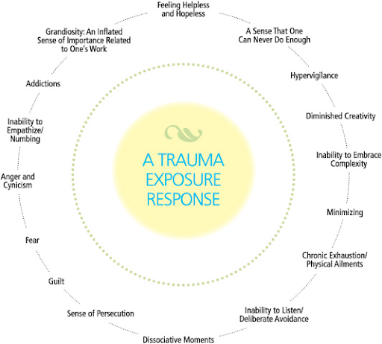
CB
Notes:
Trauma is not just an event, but a deeply distressing experience that overwhelms an individual’s ability to cope.
Trauma Stewardship: An Everyday Guide to Caring for Self While Caring for Others
Van Dernoot Vipsky, 2010

Slide 12
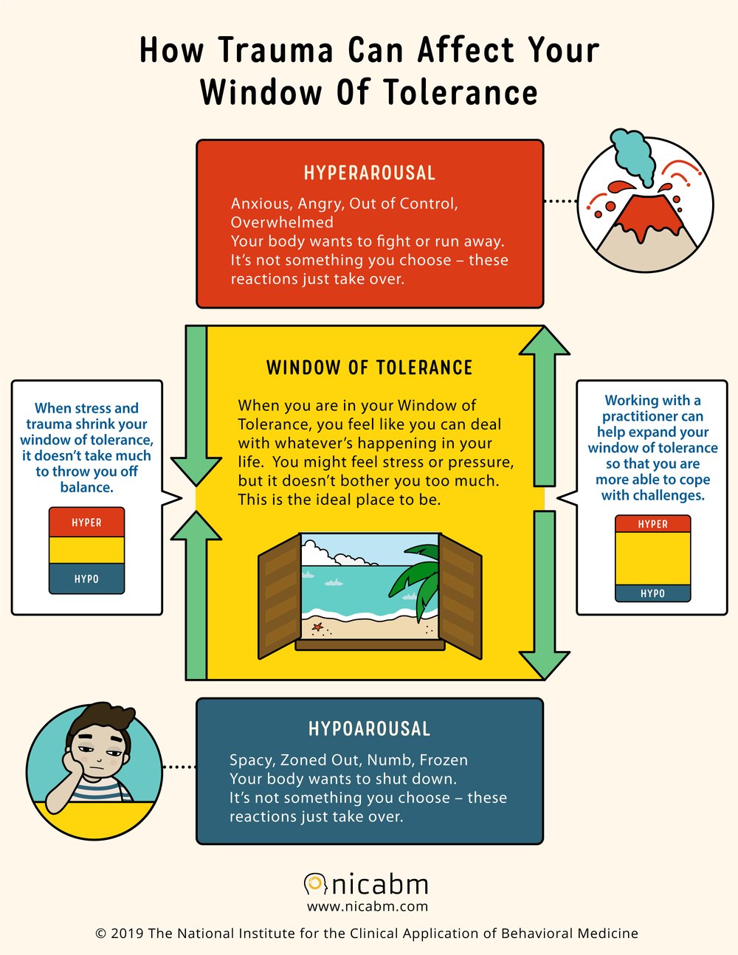

Hyperarousal
Hypoarousal
CB

